Slide 1
Motion of particles
on a friction surface
Newton’s apple team 13
202611251 Taehee Hwang
202611116 Jimin Son
202611180 Heejin Lee

Slide 2
Contents
Introduction & Contextual Background
Experimental process
Experimental result
Conclusion

Slide 3
Introduction & Contextual Background

Slide 4
Introduction
The motion of an object sliding on a curved surface is a classical mechanics problem involving gravity, friction, and surface geometry. This study is based on Motion of a Block Slipping on an Arbitrary Surface with Friction (Gonzalez-Cataldo et al., 2017), which presents a general framework for predicting when an object loses contact with a curved surface. The model relates the particle's motion to the local curvature of the surface and introduces a horizon function to determine the departure point. In this project, the theory was applied to a hemispherical acrylic surface and compared with experimental measurements.

Slide 5
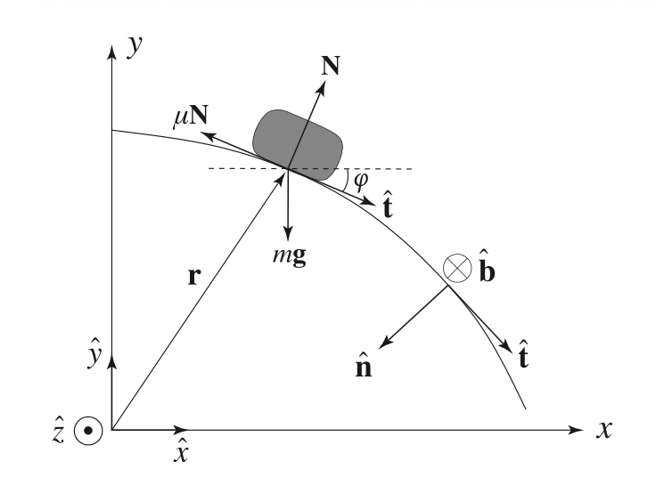

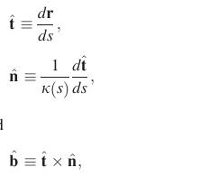
Kinematic

Slide 6
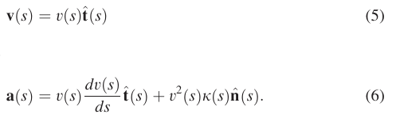
Kinematic
Velocity is always directed along the tangent vector.
The first term represents the tangential acceleration (change in speed).
The second term represents the normal acceleration (change in direction).

Slide 7
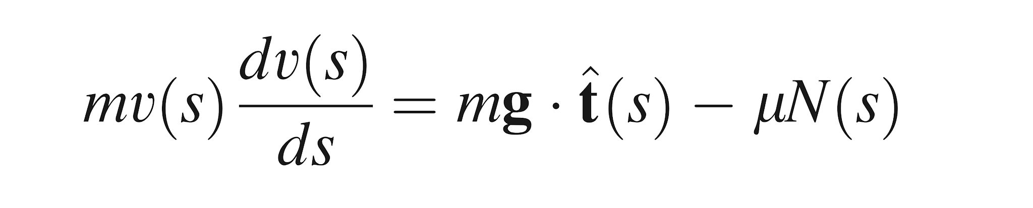
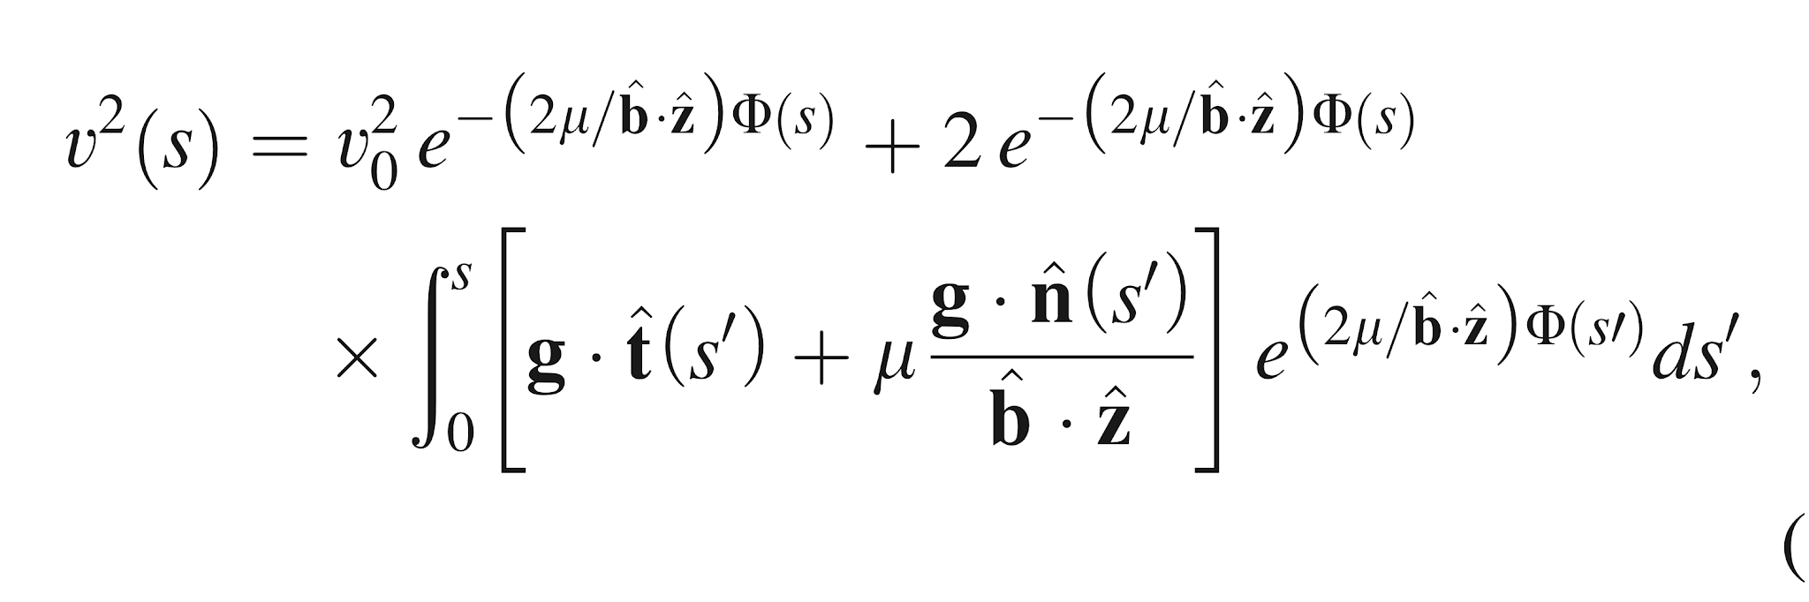
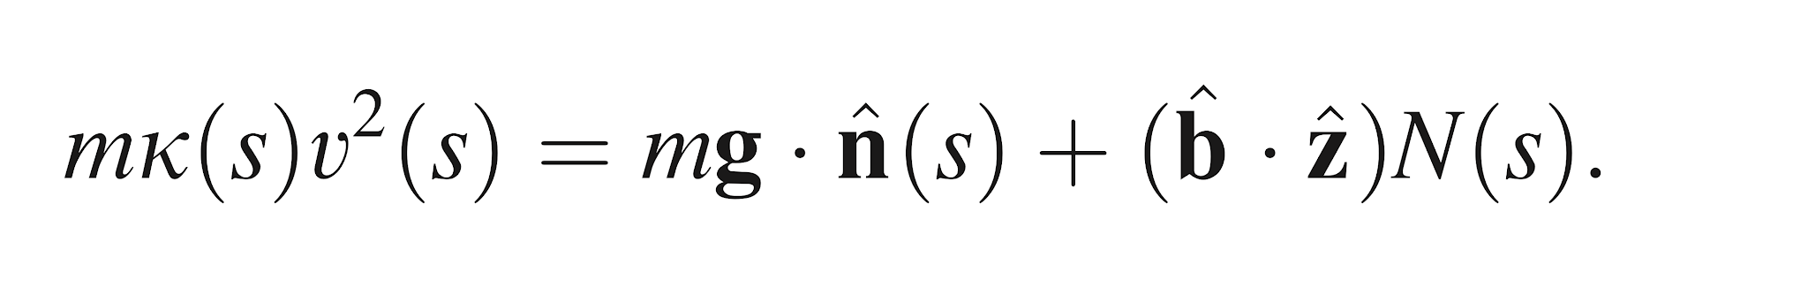
Dynamics in the Frenet-Serret frame
<the tangential equation of motion>
<the most general equation representing the velocity of a particle moving on a curved surface>
<the normal-direction equation of motion>

Slide 8
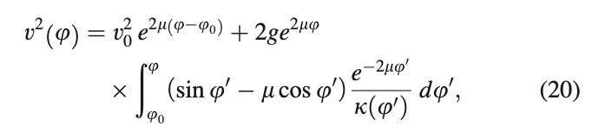

Tangent angle
Eq.1
• By introducing the tangent angle, the particle velocity can be expressed as a function of the local geometry of the curve.
• Eq.1 describes how the velocity evolves along the surface.
• Eq.2 defines the horizon function , which determines the condition for losing contact with the surface.
• These equations simplify the analysis of motion on curved surfaces.
Eq.2

Slide 9
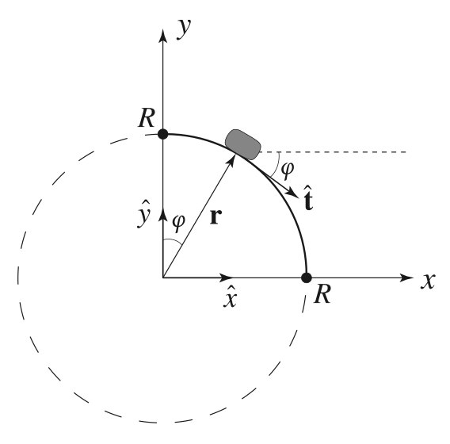
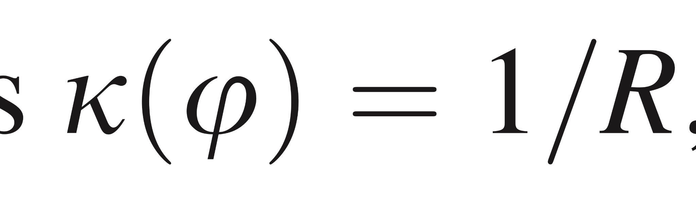

Departure from the circle

Slide 10
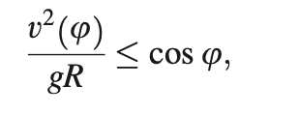

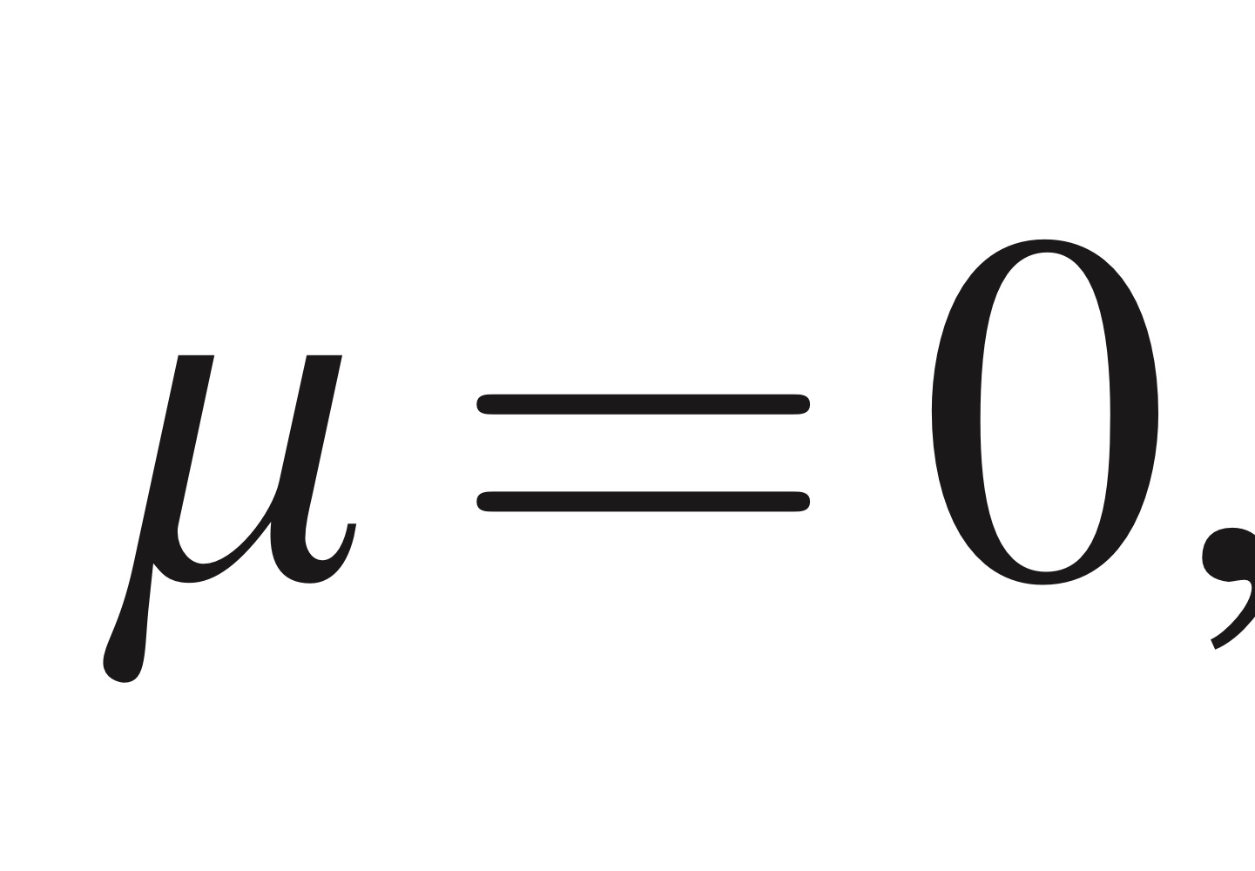
Departure from the circle
<Condition for Leaving the Surface>
<Special Case>

Slide 11
Experimental process

Slide 12
Material lists
Rectangular parallelepiped blocks Transparent hemisphere (21 cm in diameter)
Digital camera
Inclined plane (constructed from an L-shaped plastic folder)
Measuring tape

Slide 13
Experimental procedure
1. The initial drop height of the object is measured.
2. The inclined plane is secured to the apex of the transparent hemisphere.
3. A camera is positioned perpendicularly to the ground to record the experiment.
4. The block is released from the inclined plane to slide downward.

Slide 14
Experimental procedure
5. The initial velocity at the apex of the hemisphere is calculated using the law of conservation of mechanical energy.
6. The detachment angle, at which the block separates from the surface of the hemisphere, is measured through video analysis.
7. The velocity at the exact moment of detachment is determined using the position and time coordinates of the block at an arbitrary point after separation.

Slide 15
Experimental procedure
8. The friction coefficient of the acrylic hemisphere is calculated by substituting the obtained values into the governing equations from previous literature.
9. The experimental error is determined by comparing the measured friction coefficient of the acrylic hemisphere with its theoretical value.
10. The potential sources of experimental error are analyzed and discussed

Slide 16
Experimental result

Slide 17

Our Experiment Video

Slide 18
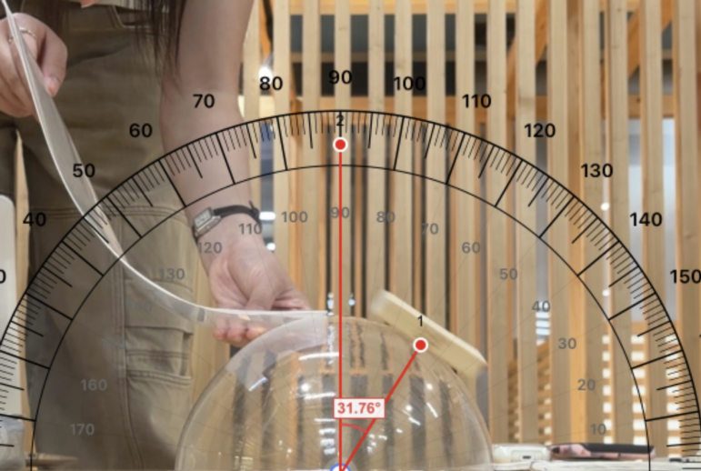
Determining the Departure Point of the Block
Measured Angle
φ = 31.76° = 0.5543 rad
Height at Point A
x(A) = Rcosφ
= 0.101 × cos(31.76°) = 0.08588 m
Horizontal Distance
y(A) = Rsinφ
= 0.101 × sin(31.76°) = 0.05316 m
Measured Time
t(A) = 0.42 s
figure1:Point A

Slide 19
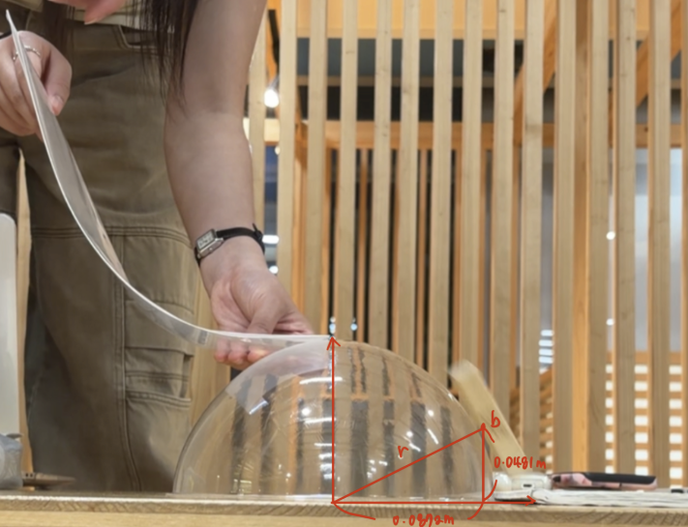
Calculating the Velocity at the Departure Point
figure2:Point B

Slide 20
Calculating the Velocity at the Departure Point
Horizontal Velocity
vx = Δx/Δt = 0.03406/0.05 = 0.6812 m/s
Vertical Velocity
Δy = vyΔt + ½gΔt²
0.03778 = vy(0.05) + ½(9.8)(0.05)²
vy = 0.5106 m/s
Speed at Point A
vA = √(vx² + vy²) = √[(0.6812)² + (0.5106)²]
= 0.8513 m/s
Time Difference
Δt = 0.47 − 0.42 = 0.05 s
Horizontal Displacement
Δx = 0.08722 − 0.05316
= 0.03406 m
Vertical Displacement
Δy = 0.08588 − 0.04810
= 0.03778 m

Slide 21
Calculating the Initial Velocity Using Energy Conservation
Given
Mass m = 0.0173 kg
Initial Height h0 = 0.288 m
Hemisphere Height htop = 0.101 m
Initial Potential Energy
PEinitial = mgh = (0.0173)(9.8)(0.288) = 0.04883 J
Potential Energy at Top
PEtop = (0.0173)(9.8)(0.101) = 0.01712 J

Slide 22
Calculating the Initial Velocity Using Energy Conservation
Kinetic Energy
KE = 0.04883 − 0.01712 = 0.03170 J
Initial Velocity KE = ½mv² v0 = √(2KE/m) = 1.914 m/s

Slide 23
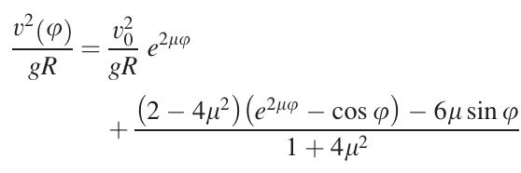
Applying the AJP Analytical Model
Known Values
v(φ) = 0.8513 m/s
v0 = 1.914 m/s
φ = 0.5543 rad
R = 0.101 m
g = 9.8 m/s²
Want to know : μ
figure3: Equation from the Paper

Slide 24
Solving for the Friction Coefficient
Numerical Solution
Substituting all known values into the model: μ = -1.17
Comparison
Expected Acrylic Friction μ ≈ 0.83
Experimental Result μ = -1.17

Slide 25
Conclusion

Slide 26
Why Did We Obtain a Negative Friction Coefficient?
Source 1
Overestimated Initial Velocity Assumption: No energy loss before reaching the hemisphere Reality: Friction existed on the guiding track
=> v0 too large : 1.914 m/s

Slide 27
Why Did We Obtain a Negative Friction Coefficient?
Source 2
Underestimated Departure Velocity
Sources of error: Air resistance Pixel scaling Motion blur Perspective distortion
=> vA too small : 0.851 m/s

Slide 28
Why Did We Obtain a Negative Friction Coefficient?
Result
Overestimated v0 + Underestimated vA
↓
Negative friction coefficient: μ = -1.17

Slide 29
Conclusions
Achievements
✓ Identified the departure point experimentally
✓ Calculated departure velocity using projectile motion
✓ Calculated initial velocity using energy conservation
✓ Applied the AJP analytical model
✓ Investigated the discrepancy between theory and experiment

Slide 30
Conclusions
Final Takeaway
The most important outcome was not the numerical value of μ, but understanding how the intermediate mathematical operations connect theoretical equations to real physical motion.

Slide 31
Thank you

